Slide 1
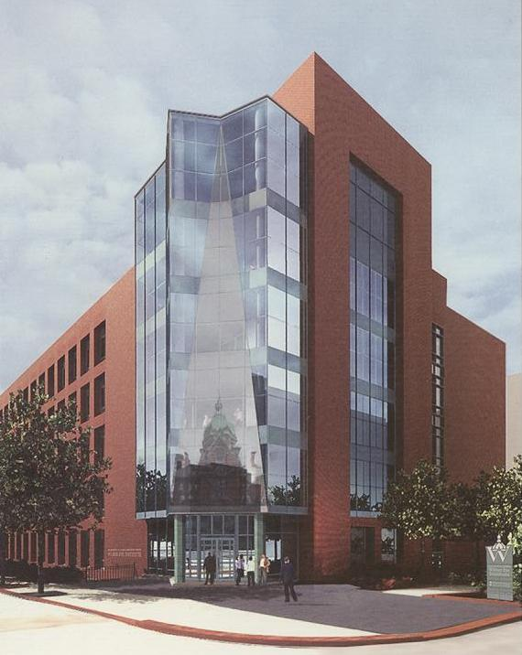
The Wilmer Eye Institute
Outline
Outpatient Surgery and Lab Building
Quick Building Stats
Introduction
  Presentation Overview
  Project Overview
  Theme
  Goals
Building envelope analysis
  Introduction
  Analysis
  Curtain Wall Prefabrication
  Recommendations / Conclusions
Infection control analysis
  Introduction
  Site Overview
  ICRA Guidelines
  Conclusions
Ultra-violet Germicidal Irradiation (UVGI) System
  Introduction
  Benefits
  Cost Analysis and Breadth Calculations
  System Implementation
  Recommendations / Conclusions
Conclusion
  Capstone Project summary
  Goal achievement
  Acknowledgments / Questions
An entity of: Johns Hopkins Hospital
The Wilmer Eye Institute Outpatient Surgery and Laboratory Building
Baltimore, MD
$65M Construction, $92M Total Project Cost
Design-Bid-Build with GMP Contract
202,000 SF
7 storeys including basement
  Outpatient Surgical Center (first floor)
  Offices and Lobby (second floor)
  Open Research Laboratories (third thru sixth floor)
Maintaining a Safe and
Functional Building
Environment
Tyler M. Smith
Construction Management
Thesis Advisor: Dr. John Messner
Baltimore, Maryland

Slide 2

Tyler M. Smith
Outline
5th Year Architectural Engineer
Quick Building Stats
Introduction
  Presentation Overview
  Project Overview
  Theme
  Goals
Building envelope analysis
  Introduction
  Analysis
  Curtain Wall Prefabrication
  Recommendations / Conclusions
Infection control analysis
  Introduction
  Site Overview
  ICRA Guidelines
  Conclusions
Ultra-violet Germicidal Irradiation (UVGI) System
  Introduction
  Benefits
  Cost Analysis and Breadth Calculations
  System Implementation
  Recommendations / Conclusions
Conclusion
  Capstone Project summary
  Goal achievement
  Acknowledgments / Questions
Construction Management Option
The Wilmer Eye Institute Outpatient Surgery and Laboratory Building
Baltimore, MD
$65M Construction, $92M Total Project Cost
Design-Bid-Build with GMP Contract
202,000 SF
7 storeys including basement
  Outpatient Surgical Center (first floor)
  Offices and Lobby (second floor)
  Open Research Laboratories (third thru sixth floor)
Starting career with RDH Building Sciences, Inc. in Portland, Oregon

Slide 3
Presentation Overview
Outline
Quick Building Stats
Introduction
  Presentation Overview
  Project Overview
  Theme
  Goals
Building envelope analysis
  Introduction
  Analysis
  Curtain Wall Prefabrication
  Recommendations / Conclusions
Infection control analysis
  Introduction
  Site Overview
  ICRA Guidelines
  Conclusions
Ultra-violet Germicidal Irradiation (UVGI) System
  Introduction
  Benefits
  Cost Analysis and Breadth Calculations
  System Implementation
  Recommendations / Conclusions
Conclusion
  Capstone Project summary
  Goal achievement
  Acknowledgments / Questions
Project Overview
Building Envelope Investigation
Infection Control Analysis
Ultraviolet Germicidal Irradiation (UVGI)
  Mechanical and Electrical Breadth Studies
Conclusions
Q & A
The Wilmer Eye Institute Outpatient Surgery and Laboratory Building
Baltimore, MD
$65M Construction, $92M Total Project Cost
Design-Bid-Build with GMP Contract
202,000 SF
7 storeys including basement
  Outpatient Surgical Center (first floor)
  Offices and Lobby (second floor)
  Open Research Laboratories (third thru sixth floor)

Slide 4
Project Overview
Outline
Quick Building Stats
Introduction
  Presentation Overview
  Project Overview
  Theme
  Goals
Building envelope analysis
  Introduction
  Analysis
  Curtain Wall Prefabrication
  Recommendations / Conclusions
Infection control analysis
  Introduction
  Site Overview
  ICRA Guidelines
  Conclusions
Ultra-violet Germicidal Irradiation (UVGI) System
  Introduction
  Benefits
  Cost Analysis and Breadth Calculations
  System Implementation
  Recommendations / Conclusions
Conclusion
  Capstone Project summary
  Goal achievement
  Acknowledgments / Questions
General Building Statistics →
Key Players
  Owner:
    Johns Hopkins Hospital
  Primary architect:
    Wilmot Sanz
  General Contractor:
    The Whiting-Turner Contracting Company
The Wilmer Eye Institute Outpatient Surgery and Laboratory Building
Baltimore, MD
$65M Construction, $92M Total Project Cost
Design-Bid-Build with GMP Contract
202,000 SF
7 storeys including basement
  Outpatient Surgical Center (first floor)
  Offices and Lobby (second floor)
  Open Research Laboratories (third thru sixth floor)

Slide 5
Project Overview
Outline
Quick Building Stats
Introduction
  Presentation Overview
  Project Overview
  Theme
  Goals
Building envelope analysis
  Introduction
  Analysis
  Curtain Wall Prefabrication
  Recommendations / Conclusions
Infection control analysis
  Introduction
  Site Overview
  ICRA Guidelines
  Conclusions
Ultra-violet Germicidal Irradiation (UVGI) System
  Introduction
  Benefits
  Cost Analysis and Breadth Calculations
  System Implementation
  Recommendations / Conclusions
Conclusion
  Capstone Project summary
  Goal achievement
  Acknowledgments / Questions
Duration
  Groundbreaking – April, 30, 2007
  Planned completion Summer ’09
    ~30 month duration
Structure
  Cast-in-place concrete
    Mildly reinforced two-way plates
The Wilmer Eye Institute Outpatient Surgery and Laboratory Building
Baltimore, MD
$65M Construction, $92M Total Project Cost
Design-Bid-Build with GMP Contract
202,000 SF
7 storeys including basement
  Outpatient Surgical Center (first floor)
  Offices and Lobby (second floor)
  Open Research Laboratories (third thru sixth floor)

Slide 6
Theme
Outline
Quick Building Stats
Introduction
  Presentation Overview
  Project Overview
  Theme
  Goals
Building envelope analysis
  Introduction
  Analysis
  Curtain Wall Prefabrication
  Recommendations / Conclusions
Infection control analysis
  Introduction
  Site Overview
  ICRA Guidelines
  Conclusions
Ultra-violet Germicidal Irradiation (UVGI) System
  Introduction
  Benefits
  Cost Analysis and Breadth Calculations
  System Implementation
  Recommendations / Conclusions
Conclusion
  Capstone Project summary
  Goal achievement
  Acknowledgments / Questions
Maintaining a safe and functional building environment
  Building Envelope
    Crucial to indoor environment integrity
  Infection control
    Extremely important in medical construction
      Patient health and sensitive laboratory experiments
  UVGI System
    Improves indoor air quality
The Wilmer Eye Institute Outpatient Surgery and Laboratory Building
Baltimore, MD
$65M Construction, $92M Total Project Cost
Design-Bid-Build with GMP Contract
202,000 SF
7 storeys including basement
  Outpatient Surgical Center (first floor)
  Offices and Lobby (second floor)
  Open Research Laboratories (third thru sixth floor)

Slide 7
Goals
Outline
Quick Building Stats
Introduction
  Presentation Overview
  Project Overview
  Theme
  Goals
Building envelope analysis
  Introduction
  Analysis
  Curtain Wall Prefabrication
  Recommendations / Conclusions
Infection control analysis
  Introduction
  Site Overview
  ICRA Guidelines
  Conclusions
Ultra-violet Germicidal Irradiation (UVGI) System
  Introduction
  Benefits
  Cost Analysis and Breadth Calculations
  System Implementation
  Recommendations / Conclusions
Conclusion
  Capstone Project summary
  Goal achievement
  Acknowledgments / Questions
Learn!
  Prepare for career
The Wilmer Eye Institute Outpatient Surgery and Laboratory Building
Baltimore, MD
$65M Construction, $92M Total Project Cost
Design-Bid-Build with GMP Contract
202,000 SF
7 storeys including basement
  Outpatient Surgical Center (first floor)
  Offices and Lobby (second floor)
  Open Research Laboratories (third thru sixth floor)

Slide 8
Building Envelope Analysis
Outline
Quick Building Stats
Introduction
  Presentation Overview
  Project Overview
  Theme
  Goals
Building envelope analysis
  Introduction
  Analysis
  Curtain Wall Prefabrication
  Recommendations / Conclusions
Infection control analysis
  Introduction
  Site Overview
  ICRA Guidelines
  Conclusions
Ultra-violet Germicidal Irradiation (UVGI) System
  Introduction
  Benefits
  Cost Analysis and Breadth Calculations
  System Implementation
  Recommendations / Conclusions
Conclusion
  Capstone Project summary
  Goal achievement
  Acknowledgments / Questions
Introduction
  Exterior enclosures
    Critical role in regulating the indoor environment
    Failures can be detrimental and costly
Technical goals
  Thermal bridging
    Issues and prevention
  Curtain-wall prefabrication
    Feasibility and practicality
The Wilmer Eye Institute Outpatient Surgery and Laboratory Building
Baltimore, MD
$65M Construction, $92M Total Project Cost
Design-Bid-Build with GMP Contract
202,000 SF
7 storeys including basement
  Outpatient Surgical Center (first floor)
  Offices and Lobby (second floor)
  Open Research Laboratories (third thru sixth floor)

Slide 9
Building Envelope Analysis
Outline
Quick Building Stats
Introduction
  Presentation Overview
  Project Overview
  Theme
  Goals
Building envelope analysis
  Introduction
  Analysis
  Curtain Wall Prefabrication
  Recommendations / Conclusions
Infection control analysis
  Introduction
  Site Overview
  ICRA Guidelines
  Conclusions
Ultra-violet Germicidal Irradiation (UVGI) System
  Introduction
  Benefits
  Cost Analysis and Breadth Calculations
  System Implementation
  Recommendations / Conclusions
Conclusion
  Capstone Project summary
  Goal achievement
  Acknowledgments / Questions
Primary exterior wall systems
  Cavity Wall
    Standard 4” brick façade
    2” air space
    2” polystyrene insulation
    Air and vapor barrier
    8” CMU back up
  Curtain Wall
    Double pane ¼” glazing
    Tubular aluminum framing
The Wilmer Eye Institute Outpatient Surgery and Laboratory Building
Baltimore, MD
$65M Construction, $92M Total Project Cost
Design-Bid-Build with GMP Contract
202,000 SF
7 storeys including basement
  Outpatient Surgical Center (first floor)
  Offices and Lobby (second floor)
  Open Research Laboratories (third thru sixth floor)

Slide 10
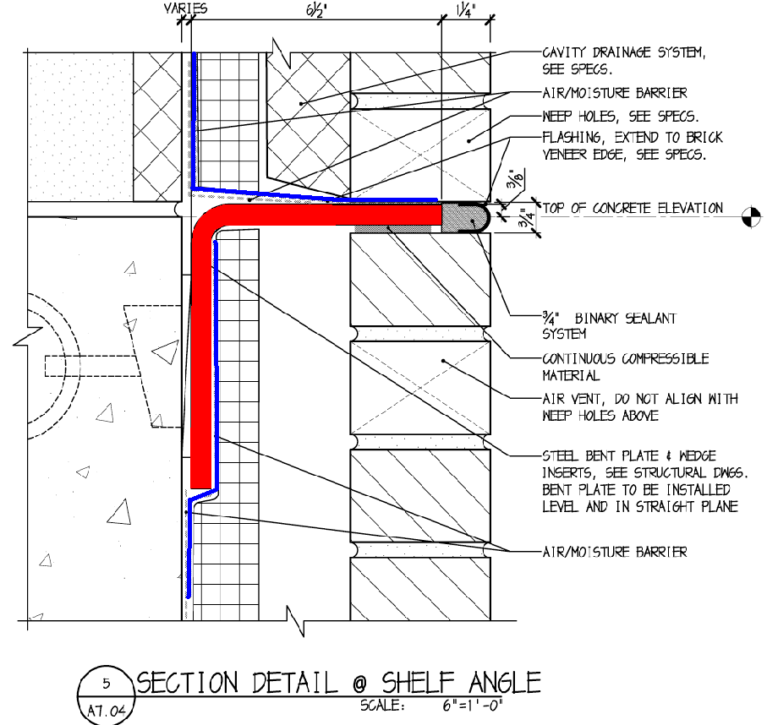
Building Envelope Analysis
Outline
Quick Building Stats
Introduction
  Presentation Overview
  Project Overview
  Theme
  Goals
Building envelope analysis
  Introduction
  Analysis
  Curtain Wall Prefabrication
  Recommendations / Conclusions
Infection control analysis
  Introduction
  Site Overview
  ICRA Guidelines
  Conclusions
Ultra-violet Germicidal Irradiation (UVGI) System
  Introduction
  Benefits
  Cost Analysis and Breadth Calculations
  System Implementation
  Recommendations / Conclusions
Conclusion
  Capstone Project summary
  Goal achievement
  Acknowledgments / Questions
Thermal bridging
  Heat is lost through wall elements of high heat flow conductance
    Steel brick shelves transfer heat from floor slab outdoors
  Issues
    “Cold-spots”
    Condensation
The Wilmer Eye Institute Outpatient Surgery and Laboratory Building
Baltimore, MD
$65M Construction, $92M Total Project Cost
Design-Bid-Build with GMP Contract
202,000 SF
7 storeys including basement
  Outpatient Surgical Center (first floor)
  Offices and Lobby (second floor)
  Open Research Laboratories (third thru sixth floor)

Slide 11
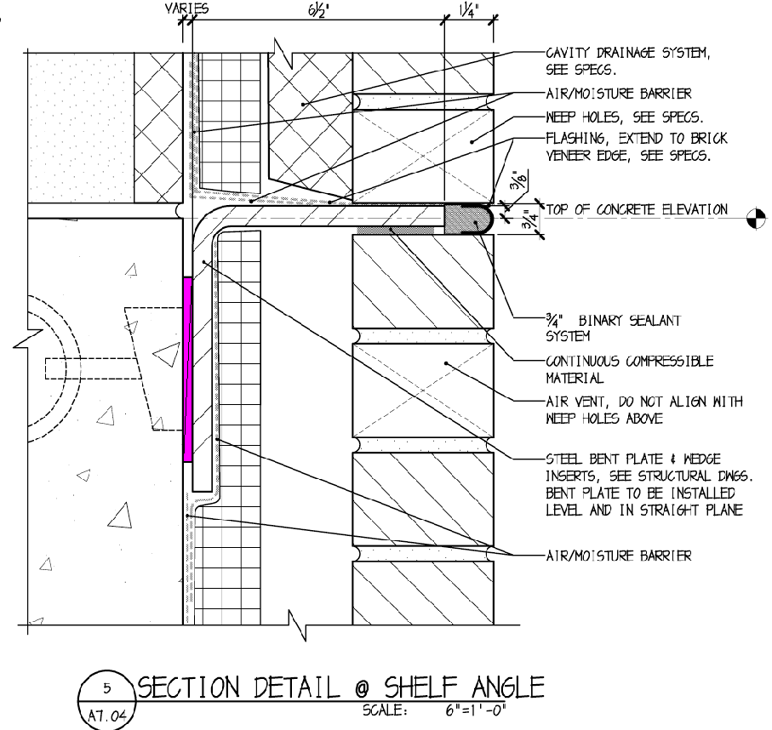
Building Envelope Analysis
Outline
Quick Building Stats
Introduction
  Presentation Overview
  Project Overview
  Theme
  Goals
Building envelope analysis
  Introduction
  Analysis
  Curtain Wall Prefabrication
  Recommendations / Conclusions
Infection control analysis
  Introduction
  Site Overview
  ICRA Guidelines
  Conclusions
Ultra-violet Germicidal Irradiation (UVGI) System
  Introduction
  Benefits
  Cost Analysis and Breadth Calculations
  System Implementation
  Recommendations / Conclusions
Conclusion
  Capstone Project summary
  Goal achievement
  Acknowledgments / Questions
Prevention
  Insert thermal “break”
  Utilize thermally insulating material in connection
The Wilmer Eye Institute Outpatient Surgery and Laboratory Building
Baltimore, MD
$65M Construction, $92M Total Project Cost
Design-Bid-Build with GMP Contract
202,000 SF
7 storeys including basement
  Outpatient Surgical Center (first floor)
  Offices and Lobby (second floor)
  Open Research Laboratories (third thru sixth floor)

Slide 12
Building Envelope Analysis
Outline
Quick Building Stats
Introduction
  Presentation Overview
  Project Overview
  Theme
  Goals
Building envelope analysis
  Introduction
  Analysis
  Curtain Wall Prefabrication
  Recommendations / Conclusions
Infection control analysis
  Introduction
  Site Overview
  ICRA Guidelines
  Conclusions
Ultra-violet Germicidal Irradiation (UVGI) System
  Introduction
  Benefits
  Cost Analysis and Breadth Calculations
  System Implementation
  Recommendations / Conclusions
Conclusion
  Capstone Project summary
  Goal achievement
  Acknowledgments / Questions
Curtain Wall Prefabrication
  Large curtain walls in NE corner of building
    Full height of building
    > 3000 SF
  5’-6’ units assembled offsite, delivered, and lifted into place by crane
  Contacted Service Glass (CW Installers)
    Have resources, but…
The Wilmer Eye Institute Outpatient Surgery and Laboratory Building
Baltimore, MD
$65M Construction, $92M Total Project Cost
Design-Bid-Build with GMP Contract
202,000 SF
7 storeys including basement
  Outpatient Surgical Center (first floor)
  Offices and Lobby (second floor)
  Open Research Laboratories (third thru sixth floor)

Slide 13
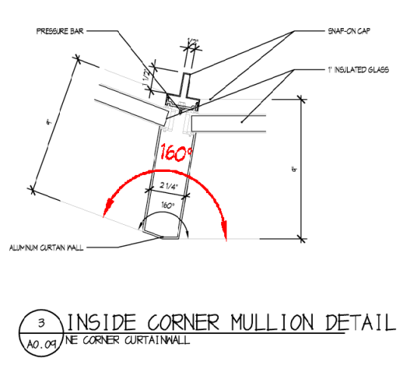
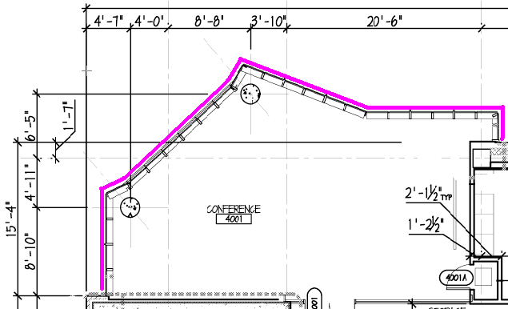
Building Envelope Analysis
Outline
Quick Building Stats
Introduction
  Presentation Overview
  Project Overview
  Theme
  Goals
Building envelope analysis
  Introduction
  Analysis
  Curtain Wall Prefabrication
  Recommendations / Conclusions
Infection control analysis
  Introduction
  Site Overview
  ICRA Guidelines
  Conclusions
Ultra-violet Germicidal Irradiation (UVGI) System
  Introduction
  Benefits
  Cost Analysis and Breadth Calculations
  System Implementation
  Recommendations / Conclusions
Conclusion
  Capstone Project summary
  Goal achievement
  Acknowledgments / Questions
Feasibility Factors
  Crane Rental
  Complex shapes
    Difficult to accurately fabricate
      Easier to take field measurements
    Risky - Small errors costly
      Could halt work in field
The Wilmer Eye Institute Outpatient Surgery and Laboratory Building
Baltimore, MD
$65M Construction, $92M Total Project Cost
Design-Bid-Build with GMP Contract
202,000 SF
7 storeys including basement
  Outpatient Surgical Center (first floor)
  Offices and Lobby (second floor)
  Open Research Laboratories (third thru sixth floor)

Slide 14
Building Envelope Analysis
Outline
Quick Building Stats
Introduction
  Presentation Overview
  Project Overview
  Theme
  Goals
Building envelope analysis
  Introduction
  Analysis
  Curtain Wall Prefabrication
  Recommendations / Conclusions
Infection control analysis
  Introduction
  Site Overview
  ICRA Guidelines
  Conclusions
Ultra-violet Germicidal Irradiation (UVGI) System
  Introduction
  Benefits
  Cost Analysis and Breadth Calculations
  System Implementation
  Recommendations / Conclusions
Conclusion
  Capstone Project summary
  Goal achievement
  Acknowledgments / Questions
Recommended Actions
  Thermal Bridging
    Insertion of plastic medium in brick shelf connection
  Curtain Wall
    Stick build as planned
Conclusions
  Envelope design & construction critical to indoor environment
    Monitor process thru entire project
  Unitization of CW not ideal in this case
The Wilmer Eye Institute Outpatient Surgery and Laboratory Building
Baltimore, MD
$65M Construction, $92M Total Project Cost
Design-Bid-Build with GMP Contract
202,000 SF
7 storeys including basement
  Outpatient Surgical Center (first floor)
  Offices and Lobby (second floor)
  Open Research Laboratories (third thru sixth floor)

Slide 15
Infection Control Analysis
Outline
Quick Building Stats
Introduction
  Presentation Overview
  Project Overview
  Theme
  Goals
Building envelope analysis
  Introduction
  Analysis
  Curtain Wall Prefabrication
  Recommendations / Conclusions
Infection control analysis
  Introduction
  Site Overview
  ICRA Guidelines
  Conclusions
Ultra-violet Germicidal Irradiation (UVGI) System
  Introduction
  Benefits
  Cost Analysis and Breadth Calculations
  System Implementation
  Recommendations / Conclusions
Conclusion
  Capstone Project summary
  Goal achievement
  Acknowledgments / Questions
Introduction
  Hospital construction projects affect the safety of many people
  Important to minimize impact negative impacts of construction on existing facilities
The Wilmer Eye Institute Outpatient Surgery and Laboratory Building
Baltimore, MD
$65M Construction, $92M Total Project Cost
Design-Bid-Build with GMP Contract
202,000 SF
7 storeys including basement
  Outpatient Surgical Center (first floor)
  Offices and Lobby (second floor)
  Open Research Laboratories (third thru sixth floor)

Slide 16
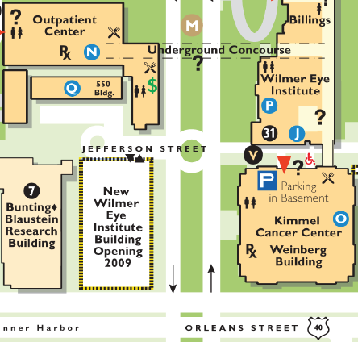
Infection Control Analysis
Outline
Quick Building Stats
Introduction
  Presentation Overview
  Project Overview
  Theme
  Goals
Building envelope analysis
  Introduction
  Analysis
  Curtain Wall Prefabrication
  Recommendations / Conclusions
Infection control analysis
  Introduction
  Site Overview
  ICRA Guidelines
  Conclusions
Ultra-violet Germicidal Irradiation (UVGI) System
  Introduction
  Benefits
  Cost Analysis and Breadth Calculations
  System Implementation
  Recommendations / Conclusions
Conclusion
  Capstone Project summary
  Goal achievement
  Acknowledgments / Questions
Building Site Overview
  Adjacent facilities
    Cancer Research Building I
    General Outpatient Center
    Weinberg Building
      Sidney Kimmel Comprehensive Cancer Center
  Many occupants
  Mostly 24 hour operation
The Wilmer Eye Institute Outpatient Surgery and Laboratory Building
Baltimore, MD
$65M Construction, $92M Total Project Cost
Design-Bid-Build with GMP Contract
202,000 SF
7 storeys including basement
  Outpatient Surgical Center (first floor)
  Offices and Lobby (second floor)
  Open Research Laboratories (third thru sixth floor)

Slide 17
Infection Control Analysis
Outline
Quick Building Stats
Introduction
  Presentation Overview
  Project Overview
  Theme
  Goals
Building envelope analysis
  Introduction
  Analysis
  Curtain Wall Prefabrication
  Recommendations / Conclusions
Infection control analysis
  Introduction
  Site Overview
  ICRA Guidelines
  Conclusions
Ultra-violet Germicidal Irradiation (UVGI) System
  Introduction
  Benefits
  Cost Analysis and Breadth Calculations
  System Implementation
  Recommendations / Conclusions
Conclusion
  Capstone Project summary
  Goal achievement
  Acknowledgments / Questions
ICRA Guidelines
  Precautions to be taken based on project criteria
  AIA Program intended to reduce risks of medical construction projects
  Copy of guidelines in appendix of report
Wilmer Building
  New major construction project
    Classified as “Type D” project
  Proximity to sensitive facilities
    Classified as highest patient risk group
The Wilmer Eye Institute Outpatient Surgery and Laboratory Building
Baltimore, MD
$65M Construction, $92M Total Project Cost
Design-Bid-Build with GMP Contract
202,000 SF
7 storeys including basement
  Outpatient Surgical Center (first floor)
  Offices and Lobby (second floor)
  Open Research Laboratories (third thru sixth floor)

Slide 18
Infection Control Analysis
Outline
Quick Building Stats
Introduction
  Presentation Overview
  Project Overview
  Theme
  Goals
Building envelope analysis
  Introduction
  Analysis
  Curtain Wall Prefabrication
  Recommendations / Conclusions
Infection control analysis
  Introduction
  Site Overview
  ICRA Guidelines
  Conclusions
Ultra-violet Germicidal Irradiation (UVGI) System
  Introduction
  Benefits
  Cost Analysis and Breadth Calculations
  System Implementation
  Recommendations / Conclusions
Conclusion
  Capstone Project summary
  Goal achievement
  Acknowledgments / Questions
Wilmer Building
  Precautions outlined in Division 1 of Specifications
  Contractors must adhere
  Primary precautions:
    Dust and debris control
    Daily site cleaning
    HEPA filter vacuums
    Construction vestibule/anteroom
The Wilmer Eye Institute Outpatient Surgery and Laboratory Building
Baltimore, MD
$65M Construction, $92M Total Project Cost
Design-Bid-Build with GMP Contract
202,000 SF
7 storeys including basement
  Outpatient Surgical Center (first floor)
  Offices and Lobby (second floor)
  Open Research Laboratories (third thru sixth floor)

Slide 19
Infection Control Analysis
Outline
Quick Building Stats
Introduction
  Presentation Overview
  Project Overview
  Theme
  Goals
Building envelope analysis
  Introduction
  Analysis
  Curtain Wall Prefabrication
  Recommendations / Conclusions
Infection control analysis
  Introduction
  Site Overview
  ICRA Guidelines
  Conclusions
Ultra-violet Germicidal Irradiation (UVGI) System
  Introduction
  Benefits
  Cost Analysis and Breadth Calculations
  System Implementation
  Recommendations / Conclusions
Conclusion
  Capstone Project summary
  Goal achievement
  Acknowledgments / Questions
Conclusions
  Project poses a significant risk to adjacent sensitive medical facilities
  ICRA guidelines must be closely followed
The Wilmer Eye Institute Outpatient Surgery and Laboratory Building
Baltimore, MD
$65M Construction, $92M Total Project Cost
Design-Bid-Build with GMP Contract
202,000 SF
7 storeys including basement
  Outpatient Surgical Center (first floor)
  Offices and Lobby (second floor)
  Open Research Laboratories (third thru sixth floor)

Slide 20
Ultraviolet Germicidal Irradiation (UVGI)
Outline
Quick Building Stats
Introduction
  Presentation Overview
  Project Overview
  Theme
  Goals
Building envelope analysis
  Introduction
  Analysis
  Curtain Wall Prefabrication
  Recommendations / Conclusions
Infection control analysis
  Introduction
  Site Overview
  ICRA Guidelines
  Conclusions
Ultra-violet Germicidal Irradiation (UVGI) System
  Introduction
  Benefits
  Cost Analysis and Breadth Calculations
  System Implementation
  Recommendations / Conclusions
Conclusion
  Capstone Project summary
  Goal achievement
  Acknowledgments / Questions
Introduction
  Micro-organisms can grow anywhere air comes into contact with moisture
  Water constantly condensing on cooling coils
    Good medium for growth of microbial spores that can cause respiratory infections
  Coils can be treated with UV light
The Wilmer Eye Institute Outpatient Surgery and Laboratory Building
Baltimore, MD
$65M Construction, $92M Total Project Cost
Design-Bid-Build with GMP Contract
202,000 SF
7 storeys including basement
  Outpatient Surgical Center (first floor)
  Offices and Lobby (second floor)
  Open Research Laboratories (third thru sixth floor)

Slide 21
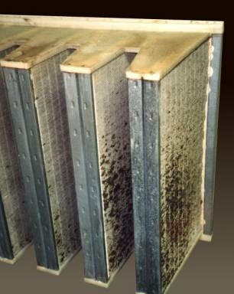
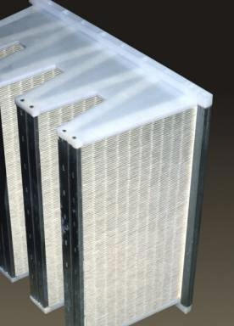
Ultraviolet Germicidal Irradiation (UVGI)
Outline
Quick Building Stats
Introduction
  Presentation Overview
  Project Overview
  Theme
  Goals
Building envelope analysis
  Introduction
  Analysis
  Curtain Wall Prefabrication
  Recommendations / Conclusions
Infection control analysis
  Introduction
  Site Overview
  ICRA Guidelines
  Conclusions
Ultra-violet Germicidal Irradiation (UVGI) System
  Introduction
  Benefits
  Cost Analysis and Breadth Calculations
  System Implementation
  Recommendations / Conclusions
Conclusion
  Capstone Project summary
  Goal achievement
  Acknowledgments / Questions
Benefits of UV in air-handling units
  Helps minimize infectious agents in airstream
  Prevents coil fouling—saves energy
    Fouled coils decrease coil heat transfer rate and air constriction increases pressure on fans
  System stays clean
    No need for maintenance (cleaning)
    Operates at design conditions for life of equipment
    Likely extends operational life of equipment
The Wilmer Eye Institute Outpatient Surgery and Laboratory Building
Baltimore, MD
$65M Construction, $92M Total Project Cost
Design-Bid-Build with GMP Contract
202,000 SF
7 storeys including basement
  Outpatient Surgical Center (first floor)
  Offices and Lobby (second floor)
  Open Research Laboratories (third thru sixth floor)

Slide 22
Ultraviolet Germicidal Irradiation (UVGI)
Outline
Quick Building Stats
Introduction
  Presentation Overview
  Project Overview
  Theme
  Goals
Building envelope analysis
  Introduction
  Analysis
  Curtain Wall Prefabrication
  Recommendations / Conclusions
Infection control analysis
  Introduction
  Site Overview
  ICRA Guidelines
  Conclusions
Ultra-violet Germicidal Irradiation (UVGI) System
  Introduction
  Benefits
  Cost Analysis and Breadth Calculations
  System Implementation
  Recommendations / Conclusions
Conclusion
  Capstone Project summary
  Goal achievement
  Acknowledgments / Questions
Cost-Benefit Analysis
  Costs
    First cost of installation
    Operating cost of UV lamps
    Annual replacement of lamps
  Savings
    Fan energy savings
    Cooling energy savings
    Maintenance savings
The Wilmer Eye Institute Outpatient Surgery and Laboratory Building
Baltimore, MD
$65M Construction, $92M Total Project Cost
Design-Bid-Build with GMP Contract
202,000 SF
7 storeys including basement
  Outpatient Surgical Center (first floor)
  Offices and Lobby (second floor)
  Open Research Laboratories (third thru sixth floor)

Slide 23
Ultraviolet Germicidal Irradiation (UVGI)
Outline
Quick Building Stats
Introduction
  Presentation Overview
  Project Overview
  Theme
  Goals
Building envelope analysis
  Introduction
  Analysis
  Curtain Wall Prefabrication
  Recommendations / Conclusions
Infection control analysis
  Introduction
  Site Overview
  ICRA Guidelines
  Conclusions
Ultra-violet Germicidal Irradiation (UVGI) System
  Introduction
  Benefits
  Cost Analysis and Breadth Calculations
  System Implementation
  Recommendations / Conclusions
Conclusion
  Capstone Project summary
  Goal achievement
  Acknowledgments / Questions
Cost-Benefit Analysis
  Followed method outlined by Dr. Kowalski, P.E.
    2006 report demonstrates cost justification of UV
  Assumed coils become fouled
    Calculate costs of additional energy required
    Compare annual savings to initial cost for payback period
    Started by assuming a 20% operational deficiency per example
The Wilmer Eye Institute Outpatient Surgery and Laboratory Building
Baltimore, MD
$65M Construction, $92M Total Project Cost
Design-Bid-Build with GMP Contract
202,000 SF
7 storeys including basement
  Outpatient Surgical Center (first floor)
  Offices and Lobby (second floor)
  Open Research Laboratories (third thru sixth floor)

Slide 24
Ultraviolet Germicidal Irradiation (UVGI)
Outline
Quick Building Stats
Introduction
  Presentation Overview
  Project Overview
  Theme
  Goals
Building envelope analysis
  Introduction
  Analysis
  Curtain Wall Prefabrication
  Recommendations / Conclusions
Infection control analysis
  Introduction
  Site Overview
  ICRA Guidelines
  Conclusions
Ultra-violet Germicidal Irradiation (UVGI) System
  Introduction
  Benefits
  Cost Analysis and Breadth Calculations
  System Implementation
  Recommendations / Conclusions
Conclusion
  Capstone Project summary
  Goal achievement
  Acknowledgments / Questions
Mechanical and Electrical Breadth Calculations
Cooling energy savings
  20% Fouling
The Wilmer Eye Institute Outpatient Surgery and Laboratory Building
Baltimore, MD
$65M Construction, $92M Total Project Cost
Design-Bid-Build with GMP Contract
202,000 SF
7 storeys including basement
  Outpatient Surgical Center (first floor)
  Offices and Lobby (second floor)
  Open Research Laboratories (third thru sixth floor)

Slide 25
Ultraviolet Germicidal Irradiation (UVGI)
Outline
Quick Building Stats
Introduction
  Presentation Overview
  Project Overview
  Theme
  Goals
Building envelope analysis
  Introduction
  Analysis
  Curtain Wall Prefabrication
  Recommendations / Conclusions
Infection control analysis
  Introduction
  Site Overview
  ICRA Guidelines
  Conclusions
Ultra-violet Germicidal Irradiation (UVGI) System
  Introduction
  Benefits
  Cost Analysis and Breadth Calculations
  System Implementation
  Recommendations / Conclusions
Conclusion
  Capstone Project summary
  Goal achievement
  Acknowledgments / Questions
Mechanical and Electrical Breadth Calculations
Fan energy savings
  20% Fouling
The Wilmer Eye Institute Outpatient Surgery and Laboratory Building
Baltimore, MD
$65M Construction, $92M Total Project Cost
Design-Bid-Build with GMP Contract
202,000 SF
7 storeys including basement
  Outpatient Surgical Center (first floor)
  Offices and Lobby (second floor)
  Open Research Laboratories (third thru sixth floor)

Slide 26
Ultraviolet Germicidal Irradiation (UVGI)
Outline
Quick Building Stats
Introduction
  Presentation Overview
  Project Overview
  Theme
  Goals
Building envelope analysis
  Introduction
  Analysis
  Curtain Wall Prefabrication
  Recommendations / Conclusions
Infection control analysis
  Introduction
  Site Overview
  ICRA Guidelines
  Conclusions
Ultra-violet Germicidal Irradiation (UVGI) System
  Introduction
  Benefits
  Cost Analysis and Breadth Calculations
  System Implementation
  Recommendations / Conclusions
Conclusion
  Capstone Project summary
  Goal achievement
  Acknowledgments / Questions
Mechanical and Electrical Breadth Calculations
UV Costs
  Contacted an undisclosed manufacturer for costs
    Each AHU requires 18 Philips PL-L60WTUV lamps
      60 nominal watts, 18 UV Watts, high output and wind chill corrected for this application
    End-user list price of $8250 per unit
    64 man-hour installation
    Project requires 156 Lamps; replacement cost is $30 per lamp
  Assumptions
    Maintenance (cleaning) cost of $1000/year before UV (per Kowalski example)
    $0.1139 average retail electricity cost in MD at end of 2007 (per U.S. DOE statistics)
    Assumed a rate of $35/hr for installation workers
  Ran through with these numbers…
The Wilmer Eye Institute Outpatient Surgery and Laboratory Building
Baltimore, MD
$65M Construction, $92M Total Project Cost
Design-Bid-Build with GMP Contract
202,000 SF
7 storeys including basement
  Outpatient Surgical Center (first floor)
  Offices and Lobby (second floor)
  Open Research Laboratories (third thru sixth floor)

Slide 27
Ultraviolet Germicidal Irradiation (UVGI)
Outline
Quick Building Stats
Introduction
  Presentation Overview
  Project Overview
  Theme
  Goals
Building envelope analysis
  Introduction
  Analysis
  Curtain Wall Prefabrication
  Recommendations / Conclusions
Infection control analysis
  Introduction
  Site Overview
  ICRA Guidelines
  Conclusions
Ultra-violet Germicidal Irradiation (UVGI) System
  Introduction
  Benefits
  Cost Analysis and Breadth Calculations
  System Implementation
  Recommendations / Conclusions
Conclusion
  Capstone Project summary
  Goal achievement
  Acknowledgments / Questions
Mechanical and Electrical Breadth Calculations
Cost-Benefit Analysis
  Payback Periods
  Payback periods seem short
  Kowalski example paid off in just a few years
The Wilmer Eye Institute Outpatient Surgery and Laboratory Building
Baltimore, MD
$65M Construction, $92M Total Project Cost
Design-Bid-Build with GMP Contract
202,000 SF
7 storeys including basement
  Outpatient Surgical Center (first floor)
  Offices and Lobby (second floor)
  Open Research Laboratories (third thru sixth floor)

Slide 28
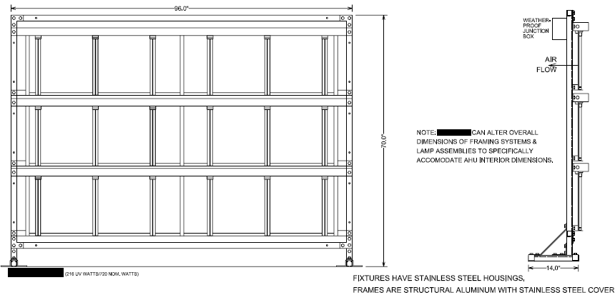
Ultraviolet Germicidal Irradiation (UVGI)
Outline
Quick Building Stats
Introduction
  Presentation Overview
  Project Overview
  Theme
  Goals
Building envelope analysis
  Introduction
  Analysis
  Curtain Wall Prefabrication
  Recommendations / Conclusions
Infection control analysis
  Introduction
  Site Overview
  ICRA Guidelines
  Conclusions
Ultra-violet Germicidal Irradiation (UVGI) System
  Introduction
  Benefits
  Cost Analysis and Breadth Calculations
  System Implementation
  Recommendations / Conclusions
Conclusion
  Capstone Project summary
  Goal achievement
  Acknowledgments / Questions
The Wilmer Eye Institute Outpatient Surgery and Laboratory Building
Baltimore, MD
$65M Construction, $92M Total Project Cost
Design-Bid-Build with GMP Contract
202,000 SF
7 storeys including basement
  Outpatient Surgical Center (first floor)
  Offices and Lobby (second floor)
  Open Research Laboratories (third thru sixth floor)
14”

Slide 29
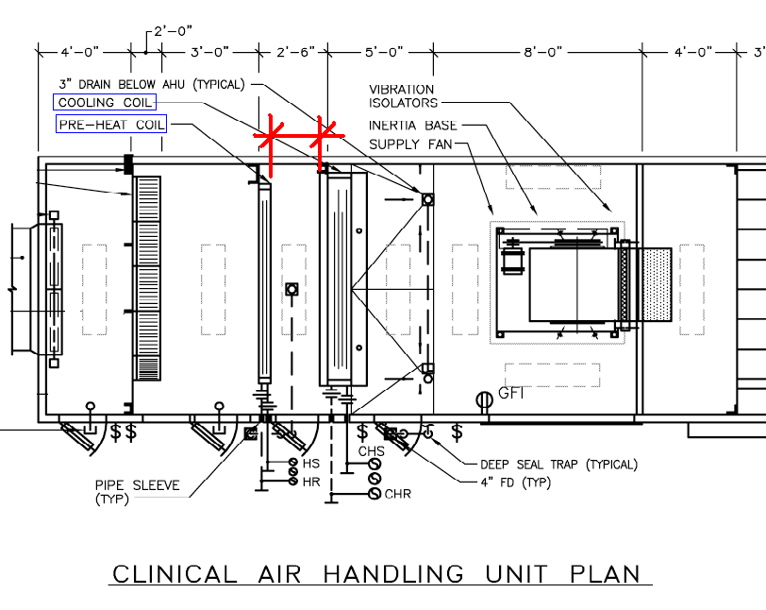
Ultraviolet Germicidal Irradiation (UVGI)
Outline
Quick Building Stats
Introduction
  Presentation Overview
  Project Overview
  Theme
  Goals
Building envelope analysis
  Introduction
  Analysis
  Curtain Wall Prefabrication
  Recommendations / Conclusions
Infection control analysis
  Introduction
  Site Overview
  ICRA Guidelines
  Conclusions
Ultra-violet Germicidal Irradiation (UVGI) System
  Introduction
  Benefits
  Cost Analysis and Breadth Calculations
  System Implementation
  Recommendations / Conclusions
Conclusion
  Capstone Project summary
  Goal achievement
  Acknowledgments / Questions
The Wilmer Eye Institute Outpatient Surgery and Laboratory Building
Baltimore, MD
$65M Construction, $92M Total Project Cost
Design-Bid-Build with GMP Contract
202,000 SF
7 storeys including basement
  Outpatient Surgical Center (first floor)
  Offices and Lobby (second floor)
  Open Research Laboratories (third thru sixth floor)
33”

Slide 30
Ultraviolet Germicidal Irradiation (UVGI)
Outline
Quick Building Stats
Introduction
  Presentation Overview
  Project Overview
  Theme
  Goals
Building envelope analysis
  Introduction
  Analysis
  Curtain Wall Prefabrication
  Recommendations / Conclusions
Infection control analysis
  Introduction
  Site Overview
  ICRA Guidelines
  Conclusions
Ultra-violet Germicidal Irradiation (UVGI) System
  Introduction
  Benefits
  Cost Analysis and Breadth Calculations
  System Implementation
  Recommendations / Conclusions
Conclusion
  Capstone Project summary
  Goal achievement
  Acknowledgments / Questions
Recommendations
  Implement UVGI system in all AHU’s
Conclusions
  UVGI is a good tool in protecting IAQ
  Systems tend to pay off in energy savings relatively quickly
The Wilmer Eye Institute Outpatient Surgery and Laboratory Building
Baltimore, MD
$65M Construction, $92M Total Project Cost
Design-Bid-Build with GMP Contract
202,000 SF
7 storeys including basement
  Outpatient Surgical Center (first floor)
  Offices and Lobby (second floor)
  Open Research Laboratories (third thru sixth floor)

Slide 31
Conclusion
Outline
Quick Building Stats
Introduction
  Presentation Overview
  Project Overview
  Theme
  Goals
Building envelope analysis
  Introduction
  Analysis
  Curtain Wall Prefabrication
  Recommendations / Conclusions
Infection control analysis
  Introduction
  Site Overview
  ICRA Guidelines
  Conclusions
Ultra-violet Germicidal Irradiation (UVGI) System
  Introduction
  Benefits
  Cost Analysis and Breadth Calculations
  System Implementation
  Recommendations / Conclusions
Conclusion
  Capstone Project summary
  Goal achievement
  Acknowledgments / Questions
Capstone Project Summary
  Building envelope critical to maintaining indoor environment
    Must be acknowledged throughout the entire project
  Prefabrication of the curtain wall unfeasible
    Need for a crane
    Complexity of the wall
The Wilmer Eye Institute Outpatient Surgery and Laboratory Building
Baltimore, MD
$65M Construction, $92M Total Project Cost
Design-Bid-Build with GMP Contract
202,000 SF
7 storeys including basement
  Outpatient Surgical Center (first floor)
  Offices and Lobby (second floor)
  Open Research Laboratories (third thru sixth floor)

Slide 32
Conclusion
Outline
Quick Building Stats
Introduction
  Presentation Overview
  Project Overview
  Theme
  Goals
Building envelope analysis
  Introduction
  Analysis
  Curtain Wall Prefabrication
  Recommendations / Conclusions
Infection control analysis
  Introduction
  Site Overview
  ICRA Guidelines
  Conclusions
Ultra-violet Germicidal Irradiation (UVGI) System
  Introduction
  Benefits
  Cost Analysis and Breadth Calculations
  System Implementation
  Recommendations / Conclusions
Conclusion
  Capstone Project summary
  Goal achievement
  Acknowledgments / Questions
Capstone Project Summary
  Infection control precautions must be taken due to the building’s close proximity to other sensitive medical facilities.
  UVGI system will effectively prevent microbial growth and will likely pay itself off in a few years through savings in energy costs.
The Wilmer Eye Institute Outpatient Surgery and Laboratory Building
Baltimore, MD
$65M Construction, $92M Total Project Cost
Design-Bid-Build with GMP Contract
202,000 SF
7 storeys including basement
  Outpatient Surgical Center (first floor)
  Offices and Lobby (second floor)
  Open Research Laboratories (third thru sixth floor)

Slide 33
Conclusion
Outline
Quick Building Stats
Introduction
  Presentation Overview
  Project Overview
  Theme
  Goals
Building envelope analysis
  Introduction
  Analysis
  Curtain Wall Prefabrication
  Recommendations / Conclusions
Infection control analysis
  Introduction
  Site Overview
  ICRA Guidelines
  Conclusions
Ultra-violet Germicidal Irradiation (UVGI) System
  Introduction
  Benefits
  Cost Analysis and Breadth Calculations
  System Implementation
  Recommendations / Conclusions
Conclusion
  Capstone Project summary
  Goal achievement
  Acknowledgments / Questions
Goal Achievement
  Learned a great deal
    Building envelope
    UVGI
    Deadlines
    Progress reporting
    Good practice with industry correspondence
  Unique opportunity to collaborate with professionals and gain real world knowledge
The Wilmer Eye Institute Outpatient Surgery and Laboratory Building
Baltimore, MD
$65M Construction, $92M Total Project Cost
Design-Bid-Build with GMP Contract
202,000 SF
7 storeys including basement
  Outpatient Surgical Center (first floor)
  Offices and Lobby (second floor)
  Open Research Laboratories (third thru sixth floor)

Slide 34
Acknowledgements
Outline
Introduction
  Presentation Overview
  Project Overview
  Theme
  Goals
Building envelope analysis
  Introduction
  Analysis
  Curtain Wall Prefabrication
  Recommendations / Conclusions
Infection control analysis
  Introduction
  Site Overview
  ICRA Guidelines
  Conclusions
Ultra-violet Germicidal Irradiation (UVGI) System
  Introduction
  Benefits
  Cost Analysis and Breadth Calculations
  System Implementation
  Recommendations / Conclusions
Conclusion
  Capstone Project summary
  Goal achievement
  Acknowledgments / Questions
Chuck Smith, Howard Reel – The Johns Hopkins Hospital Facilities Design and Construction
Terry Spencer – The Whiting Turner Contracting Company
Stefan Domby – RMF Engineering
Eric Raugh – Service Glass, Inc.
Dave Young – RDH Building Sciences, Inc.
Chuck Dunn
Dr. Jim Freihaut
Dr. Bahnfleth
Dr. Jim Messner
M. Kevin Parfitt
Mr. Andreas Phelps
My family and friends, especially my parents
My fellow 5th year Architectural Engineering students
Questions??

Slide 35
Ultraviolet Germicidal Irradiation (UVGI)
Outline
Quick Building Stats
Introduction
  Presentation Overview
  Project Overview
  Theme
  Goals
Building envelope analysis
  Introduction
  Analysis
  Curtain Wall Prefabrication
  Recommendations / Conclusions
Infection control analysis
  Introduction
  Site Overview
  ICRA Guidelines
  Conclusions
Ultra-violet Germicidal Irradiation (UVGI) System
  Introduction
  Benefits
  Cost Analysis and Breadth Calculations
  System Implementation
  Recommendations / Conclusions
Conclusion
  Capstone Project summary
  Goal achievement
  Acknowledgments / Questions
UV Costs
  Manufacturer costs
    Each AHU requires 18 Philips PL-L60WTUV lamps
      60 nominal watts, 18 UV Watts, high output and wind chill corrected for this application
    Ballasts are Advance PureVOLT UV lamp ballasts
    End-user list price of $8250 per unit
    Installation requires about 4 hours per unit, figure 8 hours for the first unit. This installation should take 2 installers a total of 4 days, less the electrical connections.
    Project requires 156 Lamps; replacement cost is $30 per lamp.
    Replacement intervals at 1 year allow for 15% depreciation in output. 2 year replacement must allow for 25% depreciation in output.
The Wilmer Eye Institute Outpatient Surgery and Laboratory Building
Baltimore, MD
$65M Construction, $92M Total Project Cost
Design-Bid-Build with GMP Contract
202,000 SF
7 storeys including basement
  Outpatient Surgical Center (first floor)
  Offices and Lobby (second floor)
  Open Research Laboratories (third thru sixth floor)

Slide 36
Ultraviolet Germicidal Irradiation (UVGI)
Outline
Quick Building Stats
Introduction
  Presentation Overview
  Project Overview
  Theme
  Goals
Building envelope analysis
  Introduction
  Analysis
  Curtain Wall Prefabrication
  Recommendations / Conclusions
Infection control analysis
  Introduction
  Site Overview
  ICRA Guidelines
  Conclusions
Ultra-violet Germicidal Irradiation (UVGI) System
  Introduction
  Benefits
  Cost Analysis and Breadth Calculations
  System Implementation
  Recommendations / Conclusions
Conclusion
  Capstone Project summary
  Goal achievement
  Acknowledgments / Questions
UV Costs
  Assumptions
    Maintenance (cleaning) cost of $1000/year before UV (per Kowalski example)
    $0.1139 average retail electricity cost in MD at end of 2007 (per U.S. DOE statistics)
    Assumed cooling coil COP of 4.1 - typical for chilled water system (from Kowalski report)
    Assumed a rate of $35/hr for installation workers
The Wilmer Eye Institute Outpatient Surgery and Laboratory Building
Baltimore, MD
$65M Construction, $92M Total Project Cost
Design-Bid-Build with GMP Contract
202,000 SF
7 storeys including basement
  Outpatient Surgical Center (first floor)
  Offices and Lobby (second floor)
  Open Research Laboratories (third thru sixth floor)

Slide 37
Ultraviolet Germicidal Irradiation (UVGI)
Outline
Quick Building Stats
Introduction
  Presentation Overview
  Project Overview
  Theme
  Goals
Building envelope analysis
  Introduction
  Analysis
  Curtain Wall Prefabrication
  Recommendations / Conclusions
Infection control analysis
  Introduction
  Site Overview
  ICRA Guidelines
  Conclusions
Ultra-violet Germicidal Irradiation (UVGI) System
  Introduction
  Benefits
  Cost Analysis and Breadth Calculations
  System Implementation
  Recommendations / Conclusions
Conclusion
  Capstone Project summary
  Goal achievement
  Acknowledgments / Questions
Cost-Benefit Analysis
  UV Data
The Wilmer Eye Institute Outpatient Surgery and Laboratory Building
Baltimore, MD
$65M Construction, $92M Total Project Cost
Design-Bid-Build with GMP Contract
202,000 SF
7 storeys including basement
  Outpatient Surgical Center (first floor)
  Offices and Lobby (second floor)
  Open Research Laboratories (third thru sixth floor)

Slide 38
Ultraviolet Germicidal Irradiation (UVGI)
Outline
Quick Building Stats
Introduction
  Presentation Overview
  Project Overview
  Theme
  Goals
Building envelope analysis
  Introduction
  Analysis
  Curtain Wall Prefabrication
  Recommendations / Conclusions
Infection control analysis
  Introduction
  Site Overview
  ICRA Guidelines
  Conclusions
Ultra-violet Germicidal Irradiation (UVGI) System
  Introduction
  Benefits
  Cost Analysis and Breadth Calculations
  System Implementation
  Recommendations / Conclusions
Conclusion
  Capstone Project summary
  Goal achievement
  Acknowledgments / Questions
Cost-Benefit Analysis
  Payback Period
    20% Fouling
The Wilmer Eye Institute Outpatient Surgery and Laboratory Building
Baltimore, MD
$65M Construction, $92M Total Project Cost
Design-Bid-Build with GMP Contract
202,000 SF
7 storeys including basement
  Outpatient Surgical Center (first floor)
  Offices and Lobby (second floor)
  Open Research Laboratories (third thru sixth floor)

Slide 39
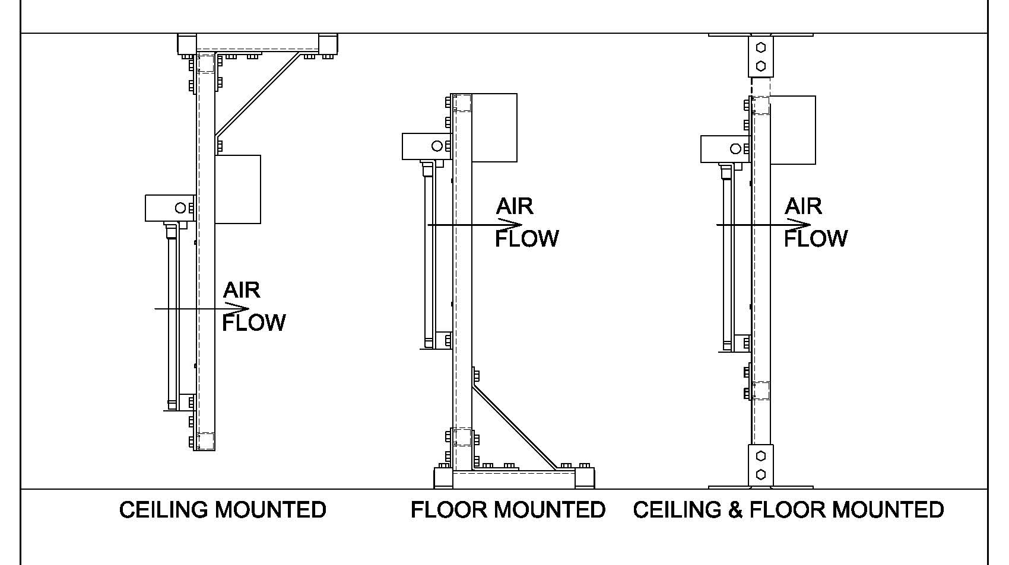
Ultraviolet Germicidal Irradiation (UVGI)
Outline
Quick Building Stats
Introduction
  Presentation Overview
  Project Overview
  Theme
  Goals
Building envelope analysis
  Introduction
  Analysis
  Curtain Wall Prefabrication
  Recommendations / Conclusions
Infection control analysis
  Introduction
  Site Overview
  ICRA Guidelines
  Conclusions
Ultra-violet Germicidal Irradiation (UVGI) System
  Introduction
  Benefits
  Cost Analysis and Breadth Calculations
  System Implementation
  Recommendations / Conclusions
Conclusion
  Capstone Project summary
  Goal achievement
  Acknowledgments / Questions
The Wilmer Eye Institute Outpatient Surgery and Laboratory Building
Baltimore, MD
$65M Construction, $92M Total Project Cost
Design-Bid-Build with GMP Contract
202,000 SF
7 storeys including basement
  Outpatient Surgical Center (first floor)
  Offices and Lobby (second floor)
  Open Research Laboratories (third thru sixth floor)

Slide 40
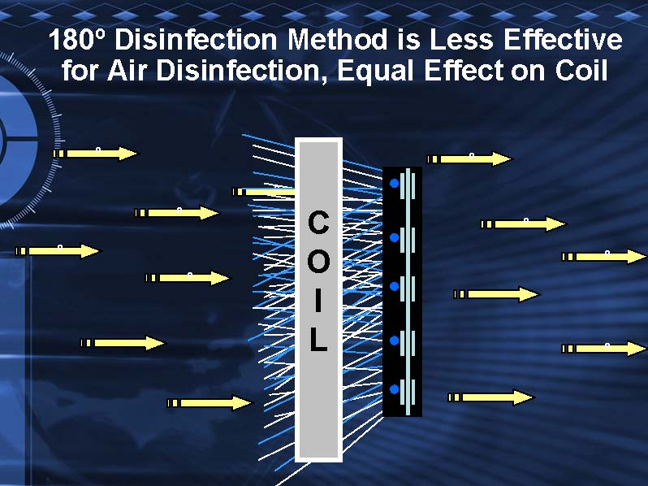
Ultraviolet Germicidal Irradiation (UVGI)
Outline
Quick Building Stats
Introduction
  Presentation Overview
  Project Overview
  Theme
  Goals
Building envelope analysis
  Introduction
  Analysis
  Curtain Wall Prefabrication
  Recommendations / Conclusions
Infection control analysis
  Introduction
  Site Overview
  ICRA Guidelines
  Conclusions
Ultra-violet Germicidal Irradiation (UVGI) System
  Introduction
  Benefits
  Cost Analysis and Breadth Calculations
  System Implementation
  Recommendations / Conclusions
Conclusion
  Capstone Project summary
  Goal achievement
  Acknowledgments / Questions
The Wilmer Eye Institute Outpatient Surgery and Laboratory Building
Baltimore, MD
$65M Construction, $92M Total Project Cost
Design-Bid-Build with GMP Contract
202,000 SF
7 storeys including basement
  Outpatient Surgical Center (first floor)
  Offices and Lobby (second floor)
  Open Research Laboratories (third thru sixth floor)

Slide 41
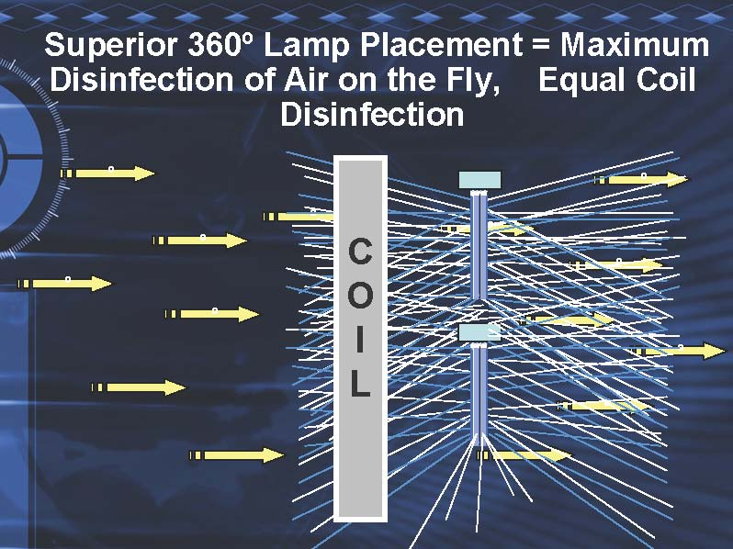
Ultraviolet Germicidal Irradiation (UVGI)
Outline
Quick Building Stats
Introduction
  Presentation Overview
  Project Overview
  Theme
  Goals
Building envelope analysis
  Introduction
  Analysis
  Curtain Wall Prefabrication
  Recommendations / Conclusions
Infection control analysis
  Introduction
  Site Overview
  ICRA Guidelines
  Conclusions
Ultra-violet Germicidal Irradiation (UVGI) System
  Introduction
  Benefits
  Cost Analysis and Breadth Calculations
  System Implementation
  Recommendations / Conclusions
Conclusion
  Capstone Project summary
  Goal achievement
  Acknowledgments / Questions
The Wilmer Eye Institute Outpatient Surgery and Laboratory Building
Baltimore, MD
$65M Construction, $92M Total Project Cost
Design-Bid-Build with GMP Contract
202,000 SF
7 storeys including basement
  Outpatient Surgical Center (first floor)
  Offices and Lobby (second floor)
  Open Research Laboratories (third thru sixth floor)

